Slide 1


Virtual Private Networks (VPN)
And
Tor Network (DarkNet)
Virtual Private Networks
Learn more »
Austin Vern Songer
https://www.linkedin.com/in/austinvernsonger
http://austinvernsonger.github.io/
http://austinvernsonger.com
Close
Save

Slide 2
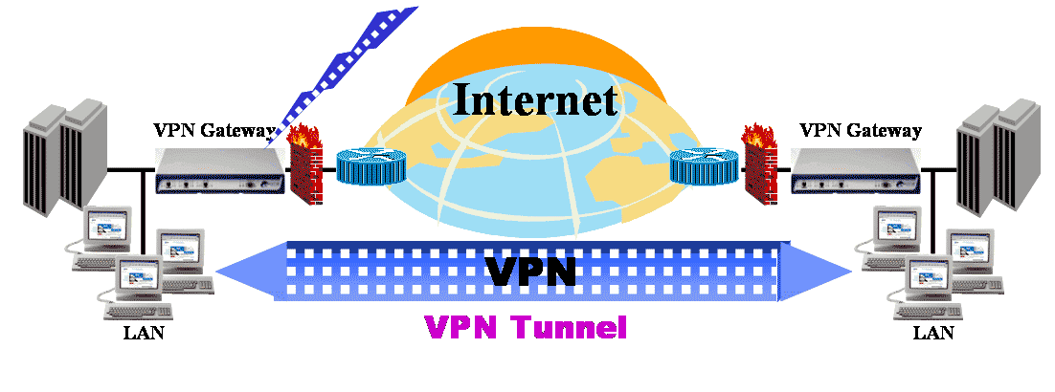

Home
Search
Virtual Private Network
is a type of private network that uses public telecommunication, such as the Internet,
Must emulate a point-to-point link
Must emulate a private link

Slide 3
QUESTION:
What Does VPN Stand For?
A. Virtual Public Network
B. Virtual Private Network
C. Virtual Protocol Network
D. Virtual Perimeter Network

Slide 4
Home
Search
Critical Functions
Data Encryption
Data Origin Authentication
Secure Generation and timely refresh of keys needed for encryption and authentication
Protection against Replay of Packets and Address Spoofing

Slide 5
Home
Search
VPN’s are usually used for:
Intranets
Remote Access
Extranets

Slide 6
Home
Search
VPN Devices
Customer (C) Devices – Are simply devices such as routers and switches located within the customer network. These devices do not have direct connectivity to the service provider networks.
Customer (CE) Devices – As the name suggests, are located at the edge of the customer network and connect to the provider network.

Slide 7
Home
Search
VPN Devices (Continued)
Service Provider (P) Devices – P Devices such as routers and switches within the provider network that do not directly connect to customer networks.
Service Provider Edge (PE) Devices – PE Devices connect directly to customer networks via CE devices.
Provider Edge Routers (PE-r)
Provider Edge Switches (PE-S)
Provider Edge devices that are capable of both routing and switching (PE-rs)

Slide 8
Home
Search
What Is IPSec and How Does It Work?
IPSec is an Internet Engineering Task Force (IETF) standard suite of protocols that provides data authentication, integrity, and confidentiality as data is transferred between communication points across IP networks

Slide 9
Home
Search
IPSec Security Benefits
• Authentication: Verifies that the packet received is actually from the claimed sender.
• Integrity: Ensures that the contents of the packet did not change in transit.
• Confidentiality: Conceals the message content through encryption.

Slide 10
Home
Search
IPSec Components
Encapsulating Security Payload (ESP): Provides confidentiality, authentication, and integrity.
• Authentication Header (AH): Provides authentication and integrity.
• Internet Key Exchange (IKE): Provides key management and Security Association (SA) management.

Slide 11
Home
Search
QUESTION
WHAT ARE THE THREE BENEFITS OF IPSec?

Slide 12
Home
Search
Encapsulating Security Payload (ESP)
ESP provides authentication, integrity, and confidentiality, which protect against data tampering and, most importantly, provide message content protection.

Slide 13
Home
Search
Authentication Header (AH)
AH provides authentication and integrity, which protect against data tampering, using the same algorithms as ESP. AH also provides optional anti-replay protection, which protects against unauthorized retransmission of packets. The authentication header is inserted into the packet between the IP header and any subsequent packet contents. The payload is not touched.

Slide 14
Home
Search
Security Association
IPSec introduces the concept of the Security Association (SA). An SA is a logical connection between two devices transferring data. An SA provides data protection for unidirectional traffic by using the defined IPSec protocols. An IPSec tunnel typically consists of two unidirectional SAs, which together provide a protected, full-duplex data channel.

Slide 15
Home
Search
The Layer Two Forwarding (L2F) Protocol
L2F is a Cisco proprietary protocol that is designed to allow the tunneling of PPP (or Serial Line Interface Protocol [SLIP]) frames between a NAS and a VPN gateway device located at a central site. Remote access users connect to the NAS, and the PPP frames from the remote access user are then tunneled over the intervening network to the VPN (home) gateway

Slide 16
Home
Search
Point-to-Point Tunneling Protocol (PPTP)
IPSec introduces the concept of the Security Association (SA). An SA is a PPTP is a protocol that was developed by a consortium of vendors, including Microsoft, 3Com, and Ascend Communications. Like L2F, PPTP allows the tunneling of remote access client PPP frames between a NAS and a VPN gateway/concentrator. PPTP also allows a tunnel to be set up directly from a remote access client to a VPN gateway/concentrator.

Slide 17
Home
Search
Layer 2 Tunneling Protocol versions 2 and 3 (L2TPv2/L2TPv3)
L2TP is an Internet Engineering Task Force (IETF) standard and combines the best features of L2F and PPTP. In a remote access environment, L2TP allows either tunneling of remote access client PPP frames via a NAS to a VPN gateway/concentrator or tunneling of PPP frames directly from the remote access client to the VPN gateway/ concentrator.

Slide 18
Home
Search
Secure Sockets Layer (SSL)
SSL is a security protocol that was originally developed by Netscape Communications (SSL versions 1, 2, and 3), and it provides secure remote access for mobile users or home users. Functionality may be limited (when compared with L2F, PPTP, L2TPv2, or IPsec) if clientless SSL remote access VPNs are deployed.

Slide 19
Home
Search
QUESTION
WHAT TWO PROTOCOLS ARE COMBINED TO MAKE UP LAYER-2 TUNNELING PROTOCOL (L2TP)

Slide 20
Home
Search
TYPES OF VPN CONNECTIONS
SITE-TO-SITE VPN CONNECTIONS
REMOTE ACCESS VPN CONNECTIONS

Slide 21
Home
Search
SITE-TO-SITE VPN
Intranet VPNs – Allows connectivity between sites of a single organization.
Extranet VPNs – Allows connectivity between an organizations such as a business partners and its customers.

Slide 22
Home
Search
QUESTION
INTRANET AND EXTRANETS IS WHAT TYPE OF VPN?

Slide 23
Home
Search
Service Provider Provisioned site-to-site VPNs Fall into one of three categories:
Layer 1 VPN – Are used to transport layer 1 services over an intervening shared network controlled and managed by Generalized Multiprotocol Labe Switching.
Layer 2 VPN – Can be provisioned between switches, hosts, and routers and allow data link layer connectivity between separate sites.
Layer 3 VPN – Interconnects hosts and routers at separate customers sites.

Slide 24
Home
Search
Layer 2 VPNS
Point-To-Point (P2P) Circuit-Based VPNs
Multipoint-To-Multipoint (M2M) VPNs

Slide 25
Home
Search
Layer 3 VPNS
PE-Based VPNs – Devices are part of the customer network routing and forward traffic based on customer network addressing.
CE-Based VPNs – These devices do not play a part in the customer nwtwork routing and forward customer traffic based on globally unique addressing.

Slide 26
Home
Search
Service Provider and Customer Provisioned Remote Access VPNs
Compulsory Tunnel Mode – Remote Access VPNs are service provider provisioned. In this mode of operation, the remote access client connects to a NAS that then tunnels client data traffic to and from a VPN gateway.
Voluntary Tunnel Mode – Remote Access VPNs are either service provider or customer provisioned. In this mode operation, data traffic is tunneled directly between the remote access client and a VPN gateway.

Slide 27
Home
Search
QUESTION
Can you establish a VPN connection between two different routers?

Slide 28
Home
Search
QUESTION
Describe the nature of the connection between a VPN client and its internal corporate network.

